Slide 1
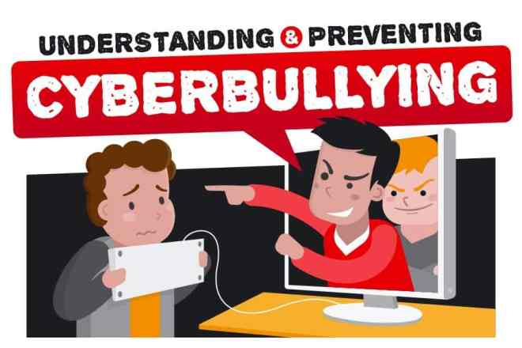
NEW DANGER FOR THE YOUTH

Slide 2
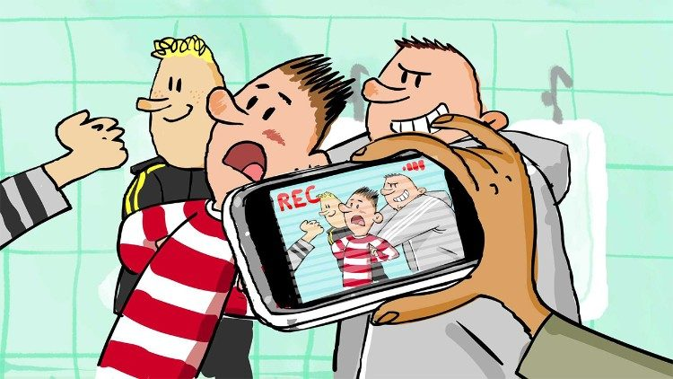
What Is Cyberbullying?
Cyberbullying is bullying with the use of digital technologies.
It can take place on social media, messaging platforms, gaming platforms and mobile phones.
It is repeated behaviour, aimed at scaring, angering or shaming those who are targeted.

Slide 3
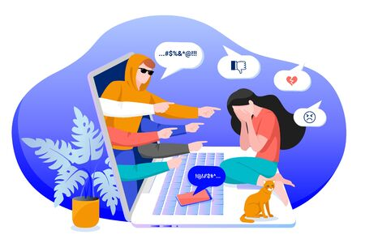
The Examples Of Cyberbullying
Examples include:
spreading lies about or posting embarrassing photos of someone on social media
sending hurtful messages or threats via messaging platforms
impersonating someone and sending mean messages to others on their behalf.

Slide 4
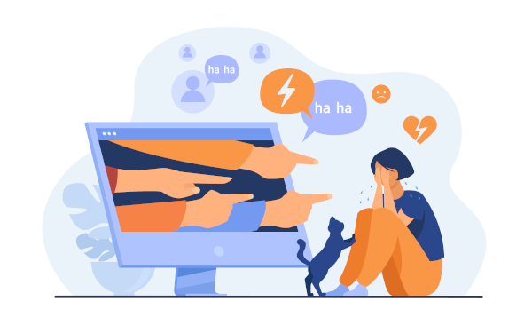
Am I being bullied online? How do I Know?
If you feel hurt or think others are laughing at you instead of with you, then the joke has gone too far.
If it continues even after you’ve asked the person to stop and you are still feeling upset about it, then this could be bullying.

Slide 5
What are the effects of cyberbullying?
When bullying happens online it can feel as if you’re being attacked everywhere, even inside your own home.
It can seem like there’s no escape.

Slide 6
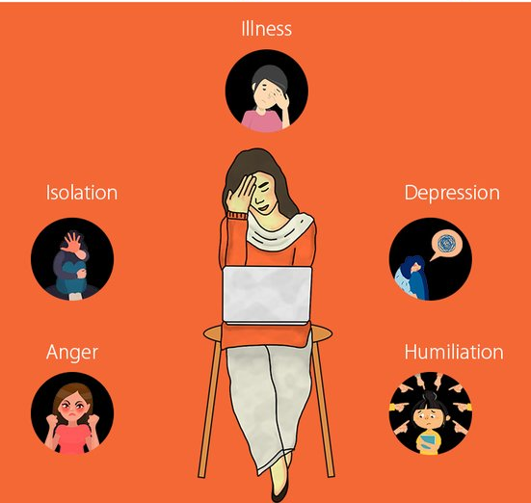
What are the effects of cyberbullying?
The effects can last a long time and affect a person in many ways:
Mentally — feeling upset, embarrassed, stupid, even angry
Emotionally — feeling ashamed or losing interest in the things you love
Physically — tired (loss of sleep), or experiencing symptoms like stomach aches and headaches

Slide 7
Why Don’t Kids Report Cyberbullying?

Slide 8
Why Don’t Kids Report Cyberbullying?

Slide 9
Why Don’t Kids Report Cyberbullying?

Slide 10
Why Don’t Kids Report Cyberbullying?

Slide 11
Why Don’t Kids Report Cyberbullying?

Slide 12
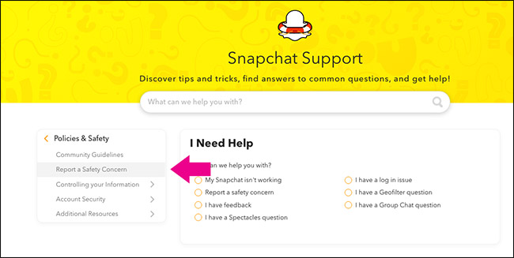
What Should I Do If Someone Is Bullying Me Online?
Seek help from someone you trust such as your parents, a close family member or another trusted adult.
In your school reach out to a counsellor, the sports coach or your favourite teacher.
Block the bully and report their behaviour on the platform itself.
Collect evidence – text messages and screen shots of social media posts – to show what’s been going on.

Slide 13
For Bullying To Stop, It Needs To Be Identified And Reporting It Is Key.

Slide 14
We Need To Be Thoughtful About What We Share Or Say That May Hurt Others.

Slide 15
Anyone Can Become A Victim Of Cyberbullying.

Slide 16
Thank You For Watching!

